Slide 1





Giornate del CUIA in Italia
Università di Bari “Aldo Moro”
11-12 Ottobre 2018
Workshop TECS - Giornate Argentine 2018
“ENERGIA DA GRADIENTI SALINI: STATO DELL’ARTE E TENDENZE”
10-11 maggio 2018
Facultad de Ciencias Químicas - Universidad Nacional de Córdoba - Ciudad de Córdoba
Prof. Giorgio Micale, Dott. Javier Luque Di Salvo - Università di Palermo

Slide 2
Outline
Objectives.
A glance into Salinity Gradient Energies concept (SGE).
Workshop location
Workshop program and execution.
Outcomes and future perspectives…

Slide 3
Objectives
1) Introduce to Argentinian partners the state-of-the-art of Salinity Gradient Energies, and related technologies.
2) Identify potential application sites for SGE.
3) Find common research interests in order to join efforts and promote the research among participants.
Why Cordoba?
In 2014, it started to function the new ‘Laboratorio de Energias Sustentables (LaES)’. The main research activities are the experimental synthesis of novel electrodes for lithium batteries.
Many researches on this field also work at DQTC, with expertise in atomistic and nanoscale modelling.
Research activities at UNIPA and UNICAL/ITM
Membrane-based technologies for water treatment and sustainable energy production. Process design, optimization and multi-scale modelling.
Currently, 5 (five) EU-funded projects at different stages of execution are being developed at UNIPA.

Slide 4
Salinity Gradient Energies
“The osmotic pressure of sea-water is about 20 atmospheres, so that when a river mixes with the sea, free energy equal to that obtainable from a waterfall 680 ft. high is lost…”
R.E. Pattle (1954)
“The solubility of sodium chloride is almost independent of temperature and, in accord with Le Chatelier’s principle, it has a very small heat of dilution. As a consequence, a large untapped source of energy has gone generally unrecognized”
G.L. Wick (1977)
REVERSE ELECTRODIALYSIS (RED)
PRESSURE RETARDED OSMOSIS (PRO)
Other SGE-related technologies:
Hydrocratic generator
Capacitive Mixing
Capacitive RED (CRED)
Microbial RED
Hybrids with parental technologies (RED/ED, etc.)
HIGH
LOW
-
-
+
LOW
-
-
+
+
-
-
+
-
+
+
-
-
-
+
+
+
-
+
-
+
+
+
-
+
LOW SALINITY
Water
Permeable
Membrane
HIGH SALINITY
Ion Exchange Membranes

Slide 5
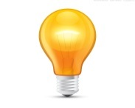
Reverse Electrodialysis
Worlwide energy production potential of SGE technologies:
- 5177 TWh (23% of electricity consumption)
- Practically available: 625 TWh (3%)
e⁻
HIGH out
LOW out
Cell-pair
OX
OX
-
-
+
Pilot plant experiences:
- Afsluitdijk (The Netherlands, Blue Energy project): 50 kW projected.
- Trapani (Italy, REAPower project): 350 – 700 W of energy production with 2 small RED units, by adopting brine as feed.
e⁻
-
-
+
+
RED
RED
-
-
+
-
+
+
-
-
-
+
+
+
-
+
-
+
+
+
-
+
HIGH in
LOW in
Ion Exchange Membranes
Notes:
RED: central topic of the workshop

Slide 6
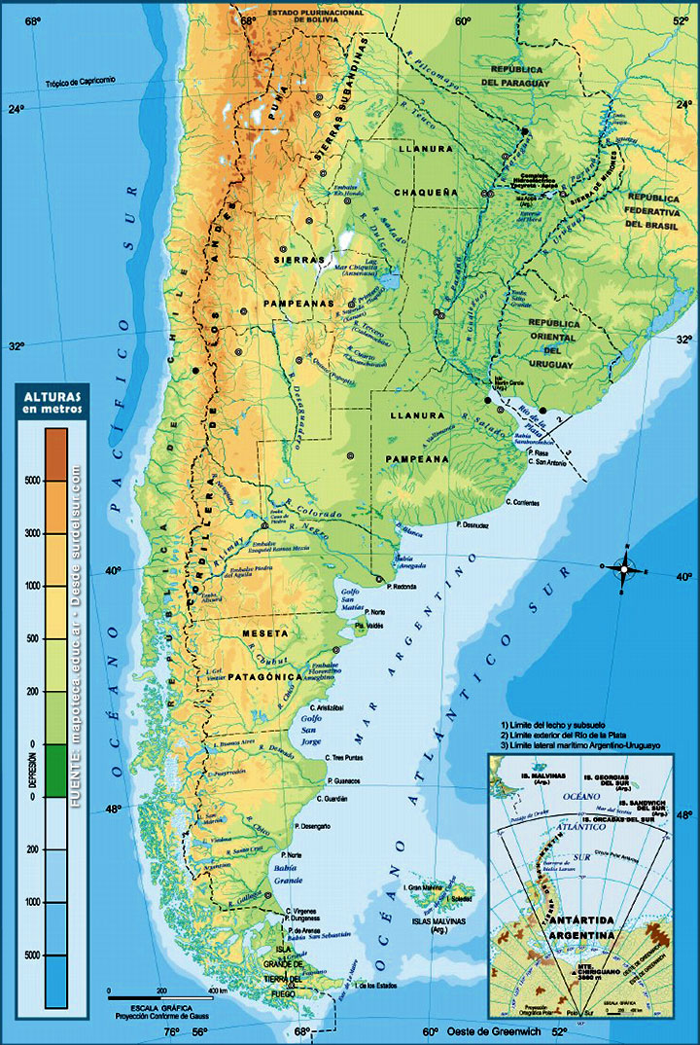
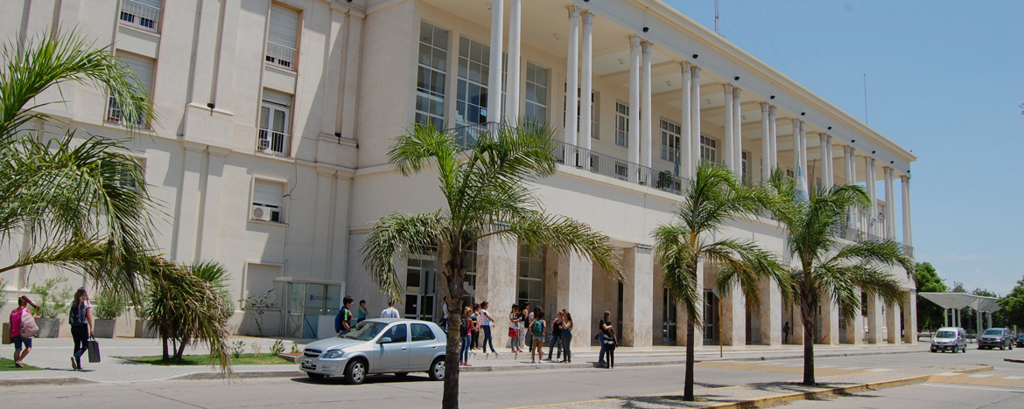
Location
Universidad Nacional de Córdoba
It was founded on 1613 (oldest of Argentina).
11,5 km² of land, 0.4 km² of built facilities (in City of Cordóba).
15 Faculties, 145 Research centers, 4 radio/TV channels, among other facilities.
132.000 students (2018 stats).
Córdoba: 2° most populated city of Argentina (1.535.868)

Slide 7
Participants:
Giorgio Micale, Javier Luque Di Salvo (Univ. di Palermo)
Stefano Curcio, Giorgio De Luca (Univ. della Calabria, Istituto per la Tecnologia delle Membrane)
Daniel Barraco, Ezequiel Leiva, Guillermina Luque, Manuel Garcia, Maria Rojas, Agustin Alvarez Ojeda, Francisco Garcia (Univ. de Cordoba) | Oscar Oviedo (Nova Vektors)
 | May 10th, Thursday |  | May 11th, Friday
09:10 | General picture of (renewable) energies in Argentina (Nova Vektors) |  | Electrode materials for lithium batteries: theory and experiment (UNC)
10:15 | Salinity Gradients Energy (SGE) fundamentals (UNIPA) |  | Brine valorisation (UNIPA)
 | (break)
11:15 | Reverse Electrodialysis (RED): benchmarks and actual challenges (UNIPA) | Ab initio computational modelling of nanostructures (UNICAL/ITM)
12:00 | SGE research projects at Università degli Studi di Palermo (UNIPA) | Ion Exchange Membranes: A broad field of applications (UNIPA-UNICAL/ITM)
14:00 – 18:30 | Experimental demonstration | Experimental demonstration
Open Seminars
Experimental

Slide 8
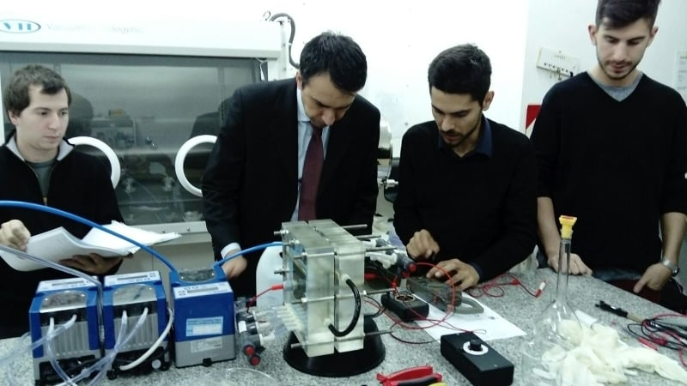
Reverse Electrodialysis
How to profit a short-time first meeting?
Open seminars + Experimental tests
Elenco del materiale necessario per le dimostrazioni sperimentali
Unità di Elettrodialisi Inversa (RED) composta da:
  Due (2) piastre di plexiglas contenenti elettrodi solidi.
  Pacco celle immerso in acqua e sale in una busta trasparente, contenenti membrane a scambio anionico e cationico (membrane di base polimerica) e spaziatori di poliacrilamida.
  Attrezzature varie (tubi, raccordi, vite, ecc.)
Tre (3) pompe peristaltiche.
Un (1) carico esterno contenenti resistenze elettriche.

Slide 9
May 10, Thursday
Seminars
09:10 General picture of (renewable) energies in Argentina (Nova Vektors)
10:15 Salinity Gradients Energy (SGE) fundamentals (UNIPA)
(break)
11:15 Reverse Electrodialysis (RED): benchmarks and actual challenges (UNIPA)
12:00 SGE research projects at Università degli Studi di Palermo (UNIPA)
Experimental demonstration
14:00 – 18:30 Experimental tests using the RED unit fed by NaCl solutions of different concentration. Electrical characterization of the RED unit. Identification of potential application sites for RED technology in Argentina.
 | Soluzione salina diluita | Soluzione salina concentrata
Test 1 | NaCl 0.017M (river) | NaCl 0.5 M (seawater)
Test 2 | Feed velocity effect

Slide 10
May 11, Friday
Seminars
09:10 Electrode materials for lithium batteries: theory and experiment (UNC)
10:15 Brine valorisation (UNIPA)
(break)
11.15 Ab initio computational modelling of nanostructures (UNICAL/ITM)
12:00 Ion Exchange Membranes: A broad field of applications (UNIPA-UNICAL/ITM)
Experimental Demonstration
14:00 – 18:30 Power density increase by adopting higher salinity streams, like brines. Open discussion: Could RED and/or parent IEM technologies be integrated to the lithium extraction process?
 | Soluzione salina diluita | Soluzione salina concentrata
Test 1 | NaCl 0.017M (river) | NaCl 5 M (brine)
Test 2 | NaCl 0.5 M (seawater) | NaCl 5 M (brine)

Slide 11
Outcomes and perspectives
‘Lithium triangle’, lithium brines
Brine management
IEM-based technologies
‘Lithium triangle’, lithium brines
Brine management
IEM-based technologies
1
‘Mar Chiquita’ salt-lake as a potential site for RED pilot plant installation
2
Low-cost Multi-scale modelling
Low-cost Multi-scale modelling
3

Slide 12
Outcomes and perspectives
Bañados del Río Dulce
Río I
Miramar (2K population)
Río II

Slide 13
Outcomes and perspectives
Fluctuating salinity, strongly depends on precipitations.
Current possible scenarios: from 40 g/l to 120 g/l.
Bucher, E. and Bucher A. Chapter 5: LIMNOLOGIA FISICA Y QUIMICA in ‘MAR CHIQUITA LAGO SALADO, CORDOBA, ARGENTINA’, ACADEMIA NACIONAL DE CIENCIAS, CÓRDOBA, ARGENTINA, 2006.

Slide 14
Outcomes and perspectives
Pilot plant projection in Mar Chiquita…?
Estimated power produced by a single RED unit
1000 cell-pairs
Fluid velocities 1 cm/s (4 m³/h needed)
  Flow rates Rivers I and II: 36000 m3/h each (minimum).
  No flow rate limitations on seawater availability expected.
Feed Spacers 270 µm.
Detailed pilot plant projection on going…
Notes:
going

Slide 15
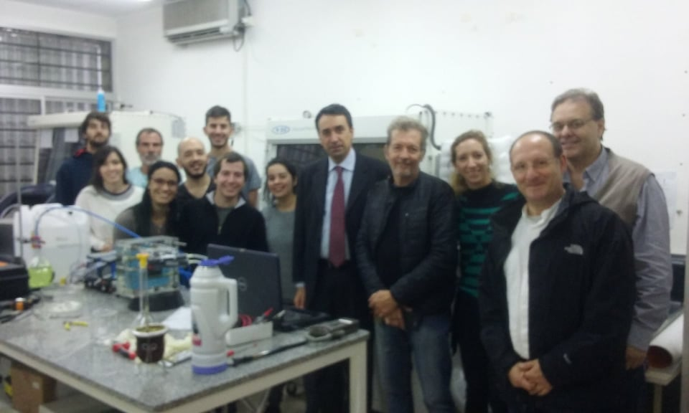
Giornate Argentine 2018
Workshop TECS
“ENERGIA DA GRADIENTI SALINI: STATO DELL’ARTE E TENDENZE”
Grazie!
Gracias!

