Slide 1
Giornate CUIA
Bari, Italy, 11-12 October 2018
Estudio de los micromecanismos de daño en fundición de hierro con grafito esferoidal de matrices ferríticas y ferrítica ausferríticas. análisis experimental y modelado computacional multi-escala
V. Di Cocco, F. Iacoviello
Università di Cassino e del Lazio Meridionale, Italy
Diego Fernandino, R. Boeri
Universidad Nacional de Mar del Plata, Argentina

Slide 2
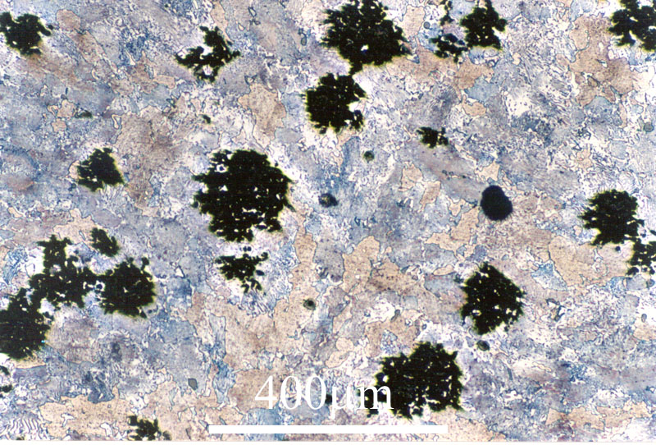
Introduction
Malleable iron was used as early as the 4th century BCE, and malleable iron artifacts have been discovered by archaeologists between 4th century BCE and 9th century CE in China.
Malleable iron is mentioned in England in a patent dating to the 1670s.
Malleable irons have good ductility and good strength
Matrix microstructure depends on the cooling rate from the graphitization annealing
Before the discovery of nodular irons, malleable irons were the only ductile class of cast irons.

Slide 3
Introduction
In 1943, during the American Foundry Society (AFS) convention, J. W. Bolton made the following statements:
Your indulgence is requested to permit the posing of one question. Will real control of graphite shape be realized in gray iron? Visualize a material, possessing (as-cast) graphite flakes or groupings resembling those of malleable iron instead of elongated flakes.
A few weeks later, in the International Nickel Company Research Laboratory, an addition of magnesium (as a copper-magnesium alloy) allowed to obtain nearly perfect spheres of graphite and, consequently, the first ductile cast iron, also known as nodular cast iron.
In 1948, always in the AFS Convention, the production of spherical graphite in iron by the addition of small amounts of cerium was announced by Henton Morrogh of the British Cast Iron Research Association.

Slide 4
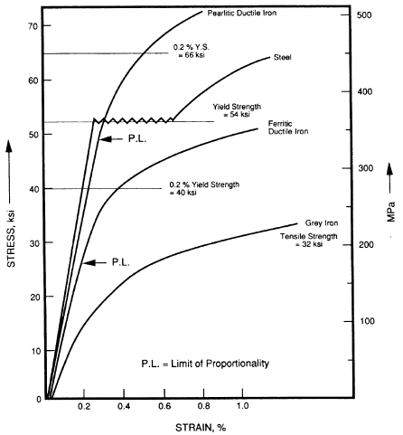
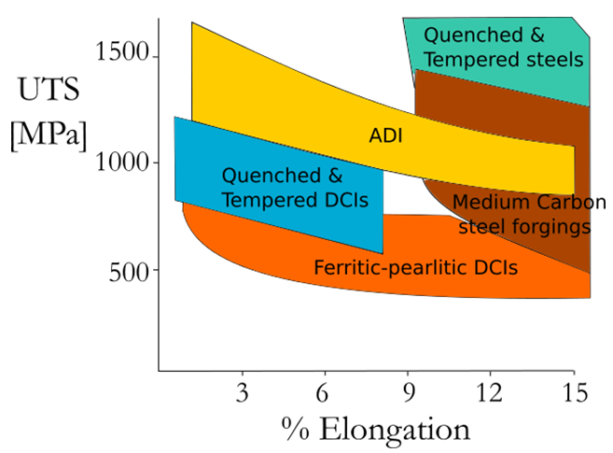
Introduction
Ductile cast irons are characterized by a very interesting combination of overall properties. Matrix controls these good mechanical properties and matrix names are commonly used to designate spheroidal cast iron types.

Slide 5
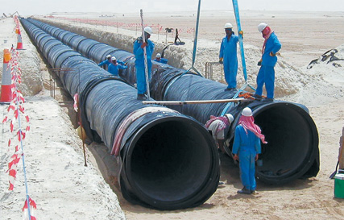
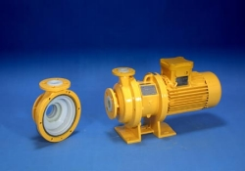
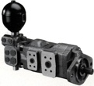
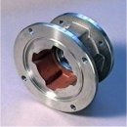
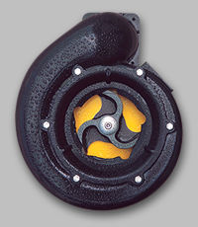
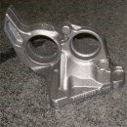
Introduction
Ductile cast irons are widely used (e.g. wheels, gears, crankshafts in cars, exhaust manifolds, valves, flywheels, boxes bearings, hubs, shafts, valves, flanges, pipelines ...)

Slide 6
Introduction
Lines of tension in cast iron with lamellar graphite are highly concentrated at the tips of the graphite lamellae.
Lines of tension in cast iron with nodular graphite flow around the graphite nodules almost undisturbed.

Slide 7
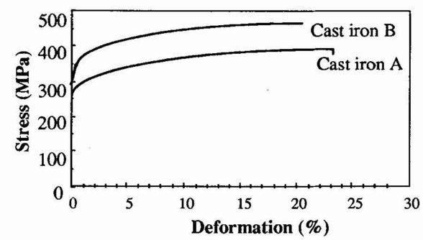
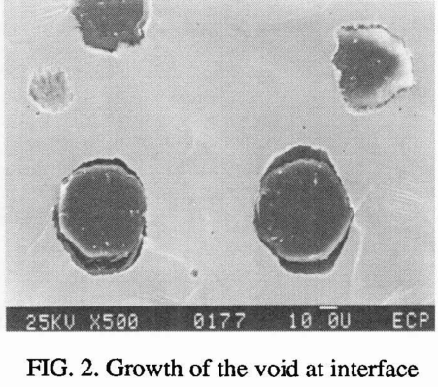
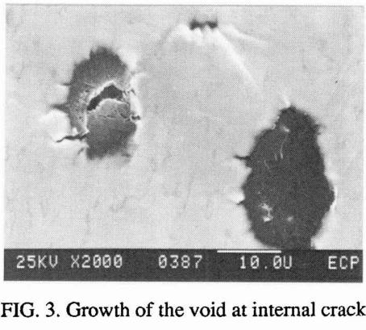
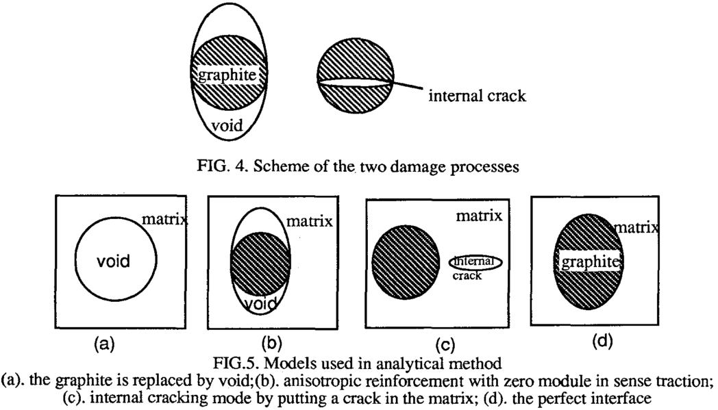
M.J. Dong, G.K. Hu, A. Diboine, D. Moulin, C. Prioul
Damage modelling in nodular cast iron
J. De Physique IV, (1993) 643-648
A
B
The different shapes of the graphite give different damage processes:
the void growth at graphite matrix interface for well developed graphite
internal cracking for degenerated graphite. These different damage modes induce different mechanical behaviors.

Slide 8
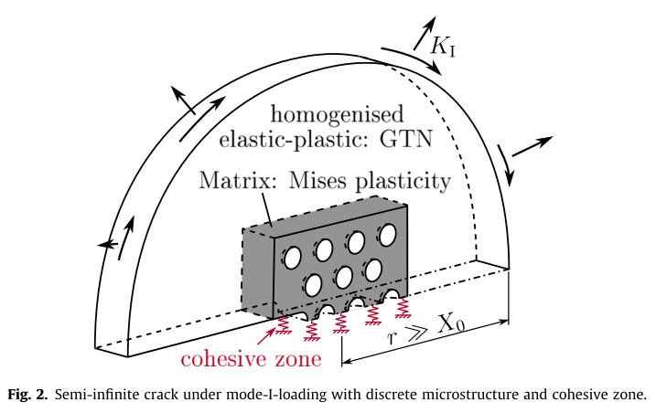
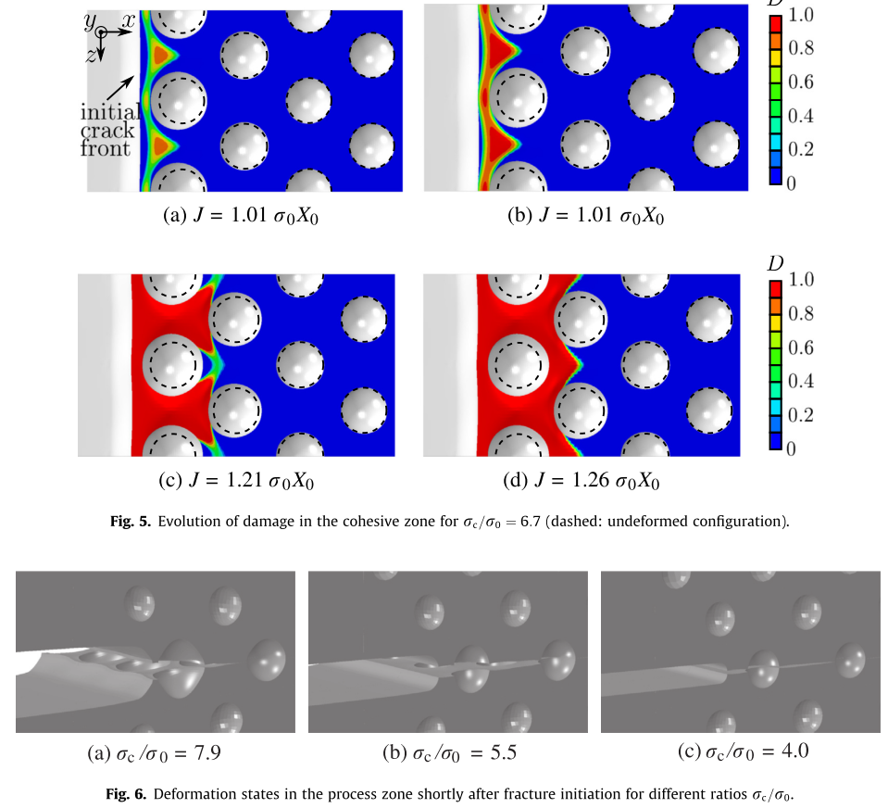
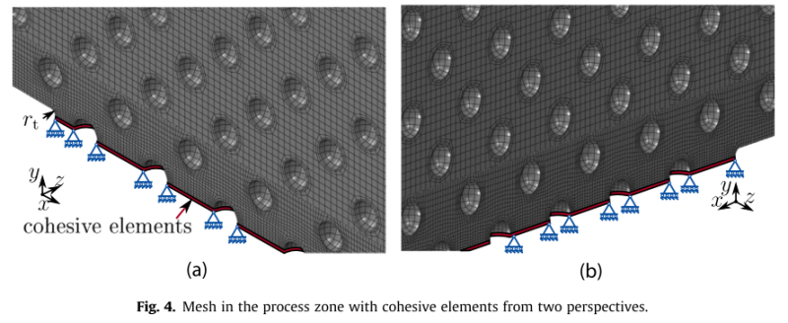
G. Hütter, L. Zybell, M. Kuna
Micromechanical modeling of crack propagation in nodular cast iron with competing ductile and cleavage failure
Engineering Fracture Mechanics 147 (2015) 388–397
The weakly bonded graphite particles are idealized to a priori existing spherical voids that are resolved discretely in the process zone at the crack tip. Possible void growth around the process zone is incorporated in a homogenized way by means of the GTN-model.

Slide 9
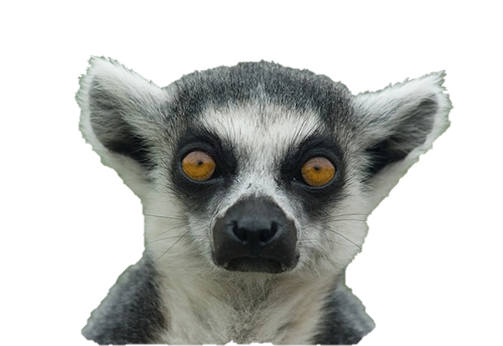
Comments
Proposed approach:
Graphite nodules
=
Graphite balls without any connection with matrix
=
Voids embedded in the matrix

Slide 10
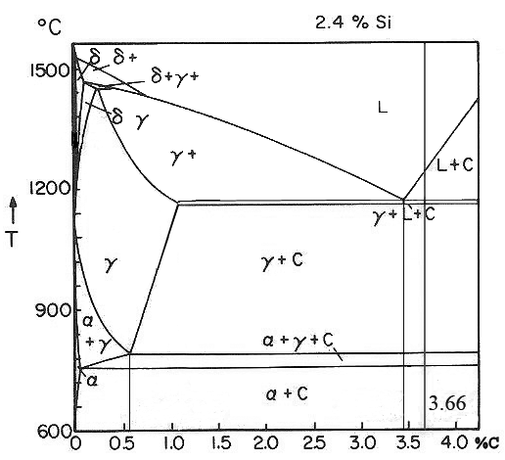
V. Di Cocco, F. Iacoviello, M. Cavallini
Damaging micromechanisms characterization of a ferritic ductile cast iron
Engineering Fracture Mechanics 77 (2010) 2016–2023
Graphite nodules could be structured as follows:
a graphite core obtained directly from the melt (C_{M});
a graphite inner shell obtained during eutectic solidification (C atoms solid diffusion through austenite shells, C_{E})
a graphite intermediate shell obtained during cooling (due to C solubility decrease in austenite grains, C_{A})
a graphite outer shell obtained during eutectoid transformation (due to the negligible C solubility in ferritic lattice, C_{F}).

Slide 11
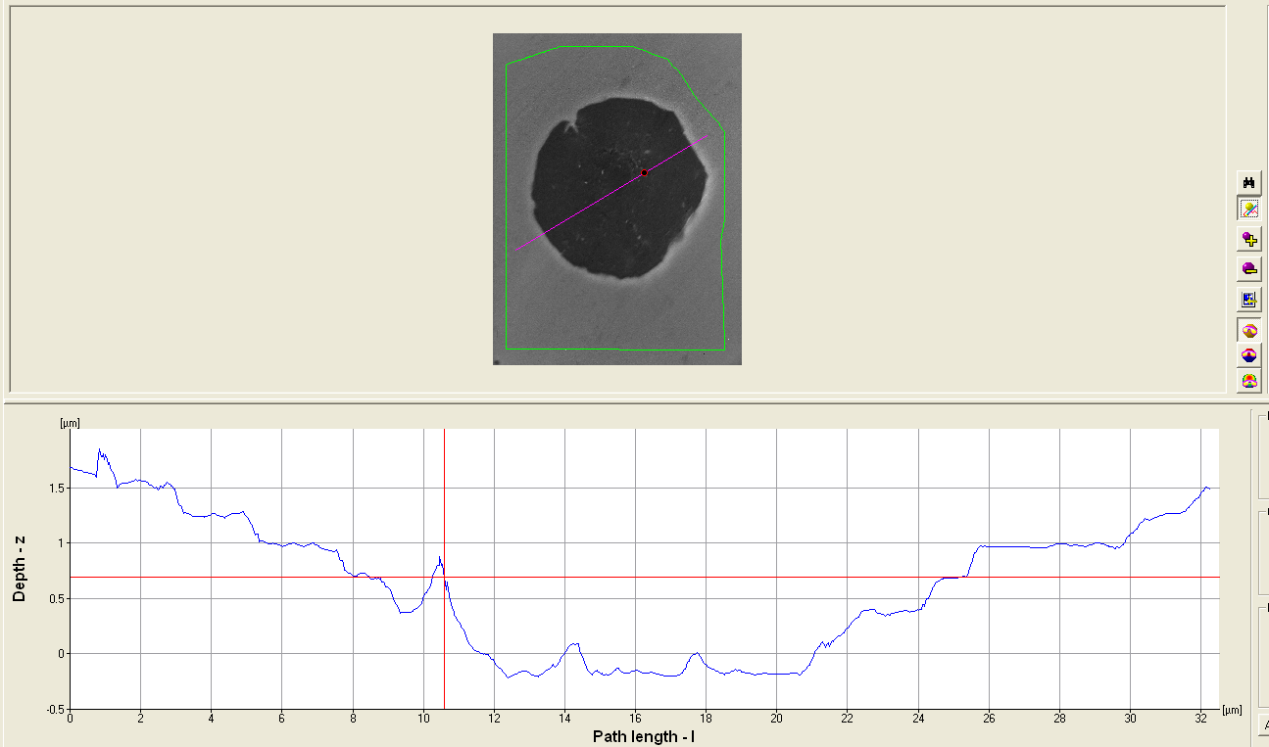
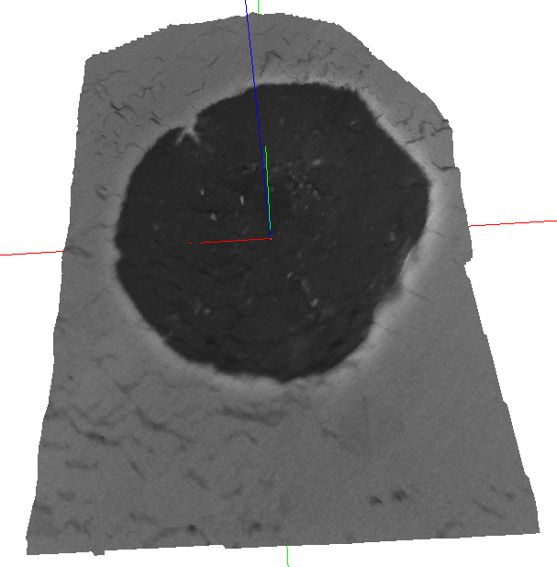
M. Cavallini, V. Di Cocco, F. Iacoviello, D. Iacoviello,
Ductile irons damaging micromechanims: graphite nodules role investigated by means of image processing procedures
IGF XXI, Cassino (FR), Italy, 2011, 415-423
Differences in the wear resistance between nodule core and nodule shell were qualitatively evaluated by means of traditional metallographic preparation, both considering a 3D surface reconstruction and performing a customized image processing procedures: the nodule core seemed to be characterized by a lower wearing resistance if compared to the nodule outer shell.

Slide 12
A. De Santis, D. Iacoviello, V. Di Cocco, F. Iacoviello
Graphite nodules features identifications and damaging micromechanisms in ductile irons
Frattura ed Integrità Strutturale, 26 (2013) 12-21
Different quantitative image analysis procedures were optimized, both to characterize the graphite elements morphologies and to quantify the damage level.
In the video, the image segmentation by the active contours method is optimized.
Focusing the ductile irons, it is important to recognize how far is the shape from a circular one and the possible presence of holes inside. For the description of the shape of the spheroids the Area, the Eccentricity and the Solidity parameters may be here considered for the specimen classification.

Slide 13
M. Cavallini, V. Di Cocco, F. Iacoviello, D. Iacoviello,
Ductile irons damaging micromechanims: graphite nodules role investigated by means of image processing procedures
IGF XXI, Cassino (FR), Italy, 2011, 415-423

Slide 14
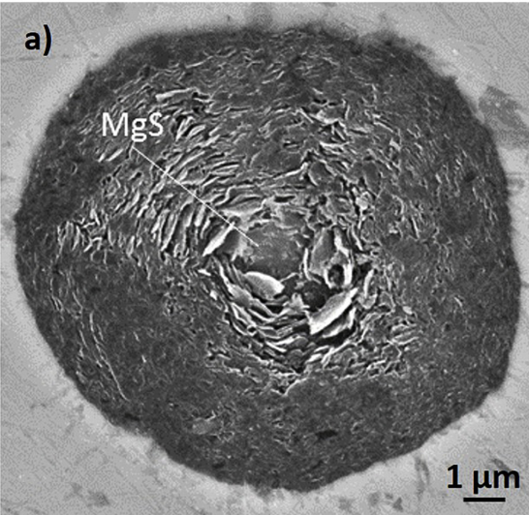
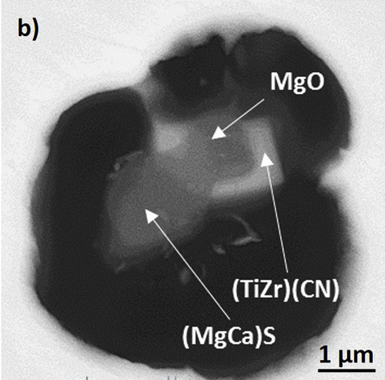
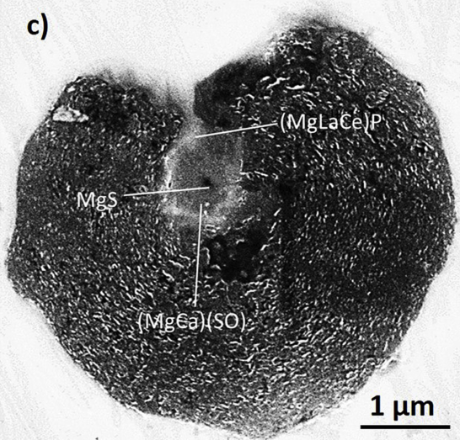
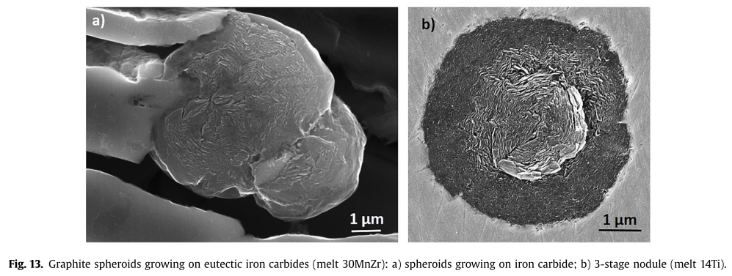
D.M. Stefanescu, G. Alonso, P. Larrañaga, E. De la Fuente, R. Suarez
Reexamination of crystal growth theory of graphite in iron-carbon alloys
Acta Materialia 139 (2017) 109-121
Graphite nodules nucleation

Slide 15
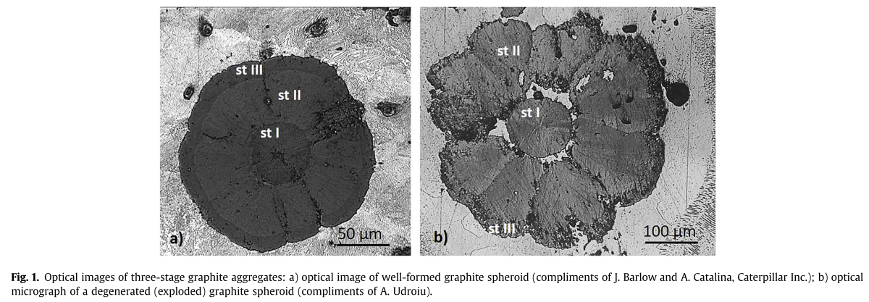
D.M. Stefanescu, G. Alonso, P. Larrañaga, E. De la Fuente, R. Suarez
Reexamination of crystal growth theory of graphite in iron-carbon alloys
Acta Materialia 139 (2017) 109-121
The room temperature graphite spheroid is the product of three successive events:
nucleation and growth in the liquid;
growth during the eutectic transformation via carbon diffusion through the austenite shell;
growth during cooling to room temperature as the solubility of carbon in austenite decreases.

Slide 16
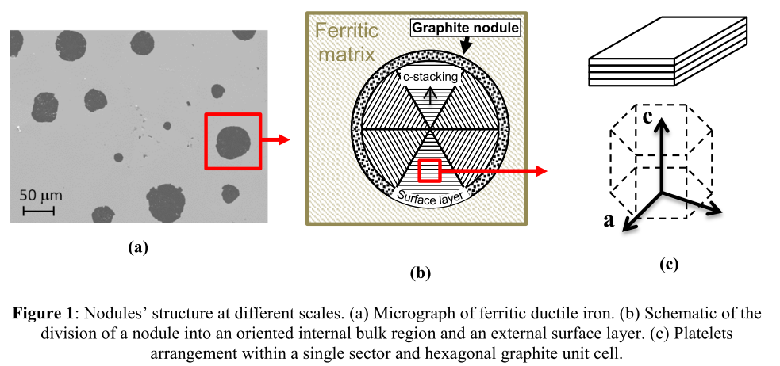
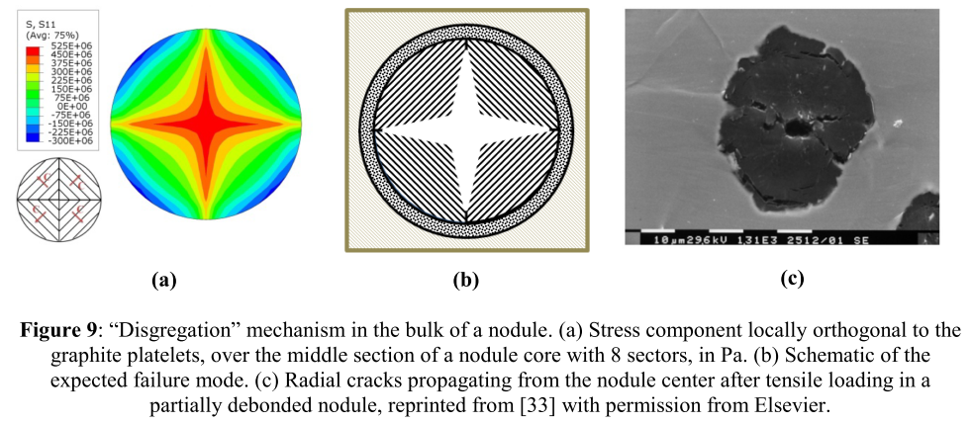
T. Andriollo, J. Thorborg, N. Tiedje, J. Hattel
A micro-mechanical analysis of thermo-elastic properties and local residual stresses in ductile iron based on a new anisotropic model for the graphite nodules
Modelling and Simulation in Materials Science and Engineering, 24 (2016) 0550112
The thermo-elastic behavior of the graphite nodules contained in ductile iron was derived on the basis of recent transmission electron microscopy investigations of their real internal structure.
The obtained accurate description of the stress & strain field at the micro scale was used to shed light on common failure modes reported for the nodules and on some peculiar properties observed in ductile iron at both micro and macro scale

Slide 17
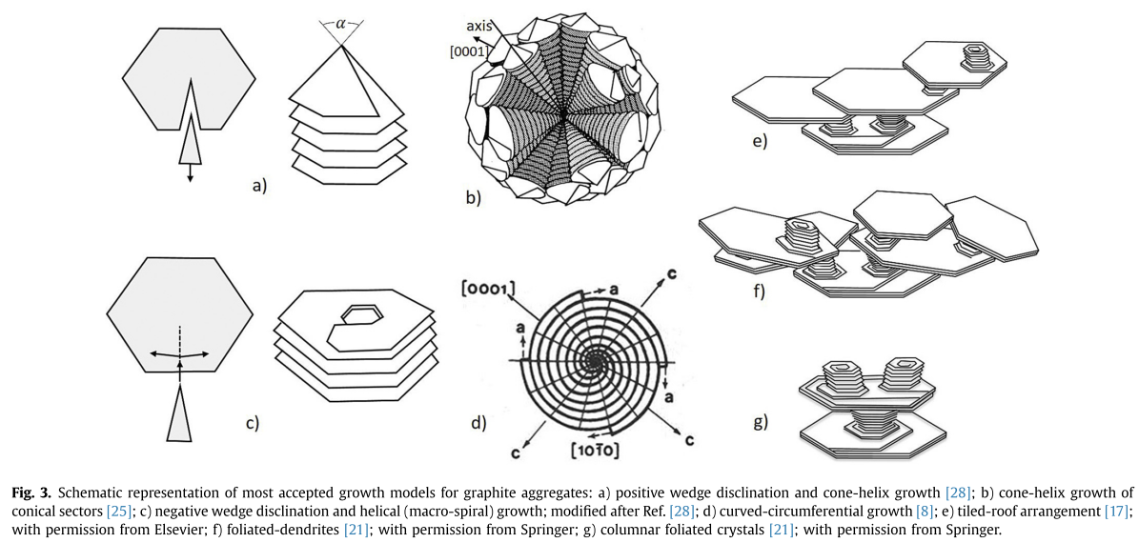
D.M. Stefanescu, G. Alonso, P. Larrañaga, E. De la Fuente, R. Suarez
Reexamination of crystal growth theory of graphite in iron-carbon alloys
Acta Materialia 139 (2017) 109-121

Slide 18
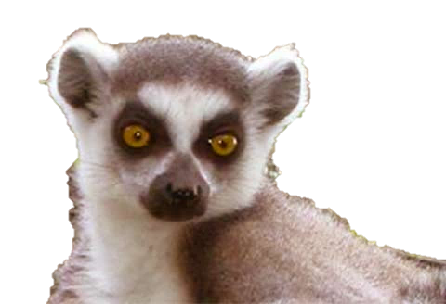
Comments
OK … graphite elements can’t be considered as voids …
is this important for the fatigue crack propagation in DCIs?

Slide 19
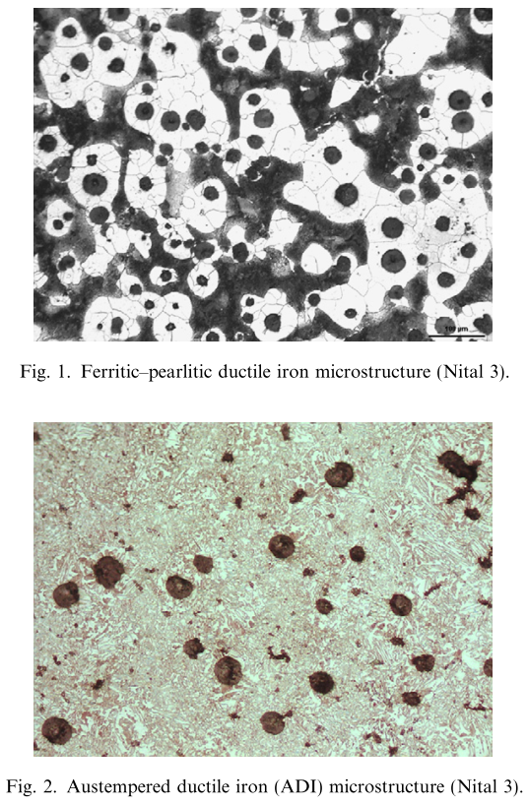
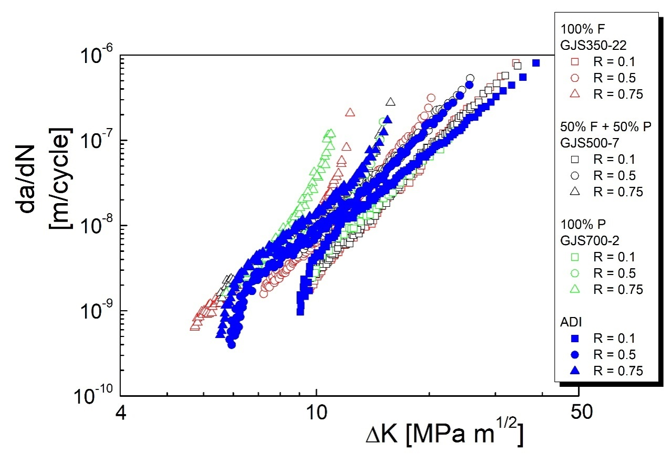
M. Cavallini, O. Di Bartolomeo, F. Iacoviello
Fatigue crack propagation damaging micromechanisms in ductile cast irons
Engineering Fracture Mechanics 75 (2008) 694–704

Slide 20
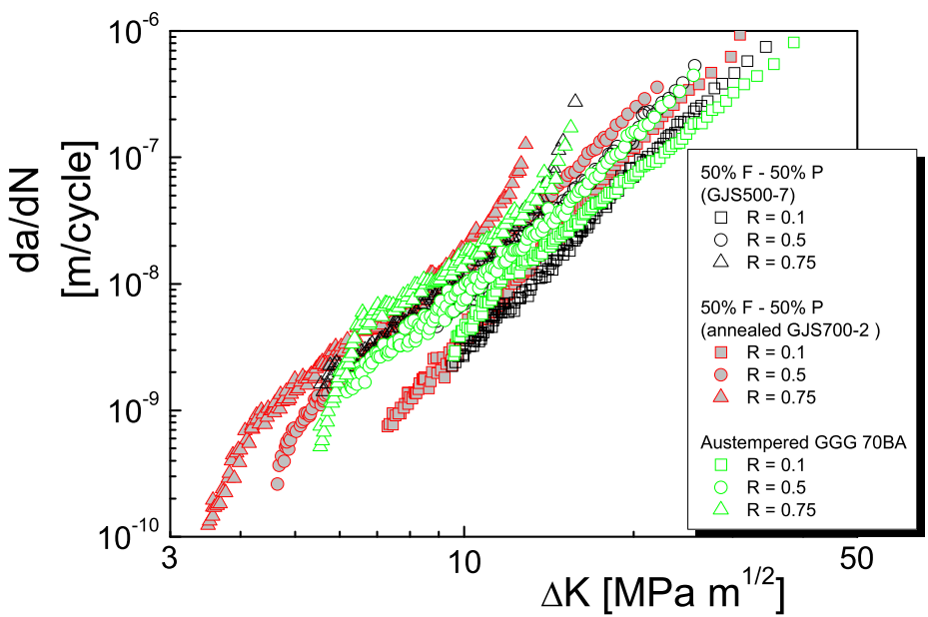
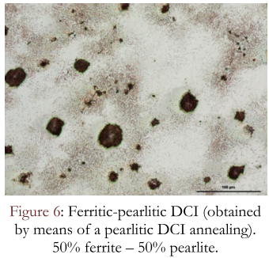
F. Iacoviello, V. Di Cocco, M. Cavallini
Ductile cast irons: microstructure influence on fatigue crack propagation resistance
Frattura ed Integrità Strutturale, 13 (2010) 3-16

Slide 21
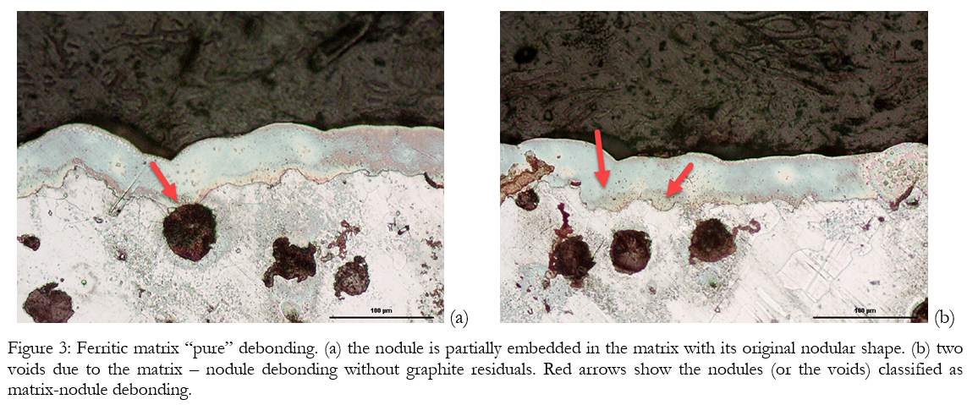
F. Iacoviello, V. Di Cocco
To be published
Debonding
Onion-like
Disaggregation

Slide 22
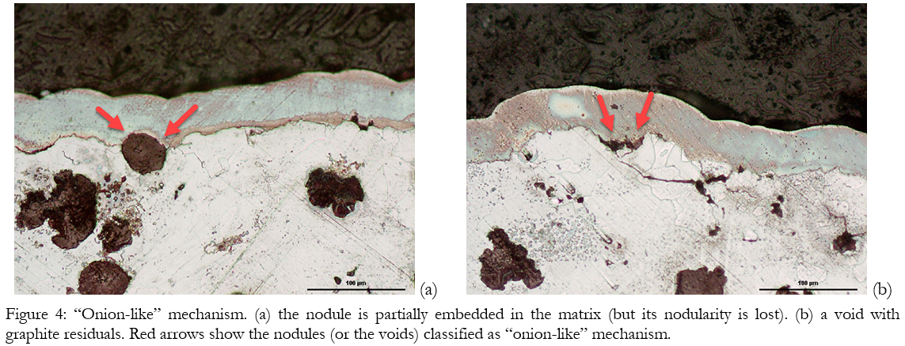
F. Iacoviello, V. Di Cocco
To be published
Debonding
Onion-like
Disaggregation

Slide 23
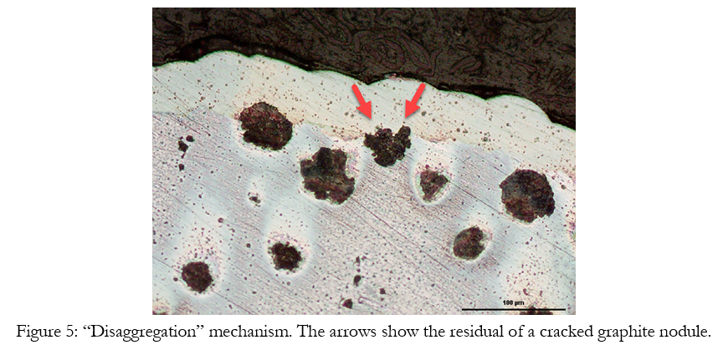
F. Iacoviello, V. Di Cocco
To be published
Debonding
Onion-like
Disaggregation

Slide 24
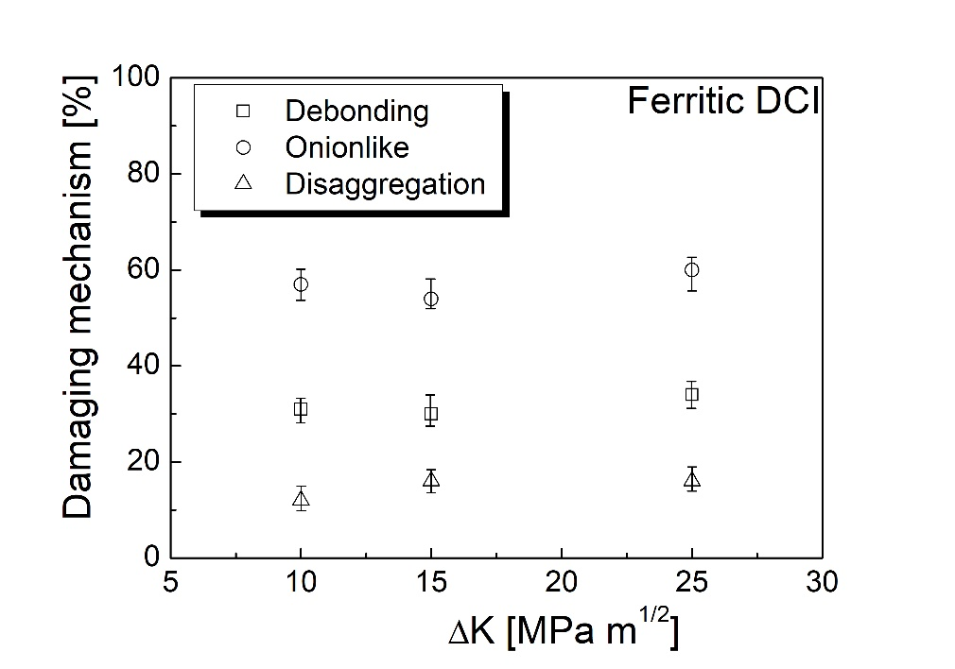
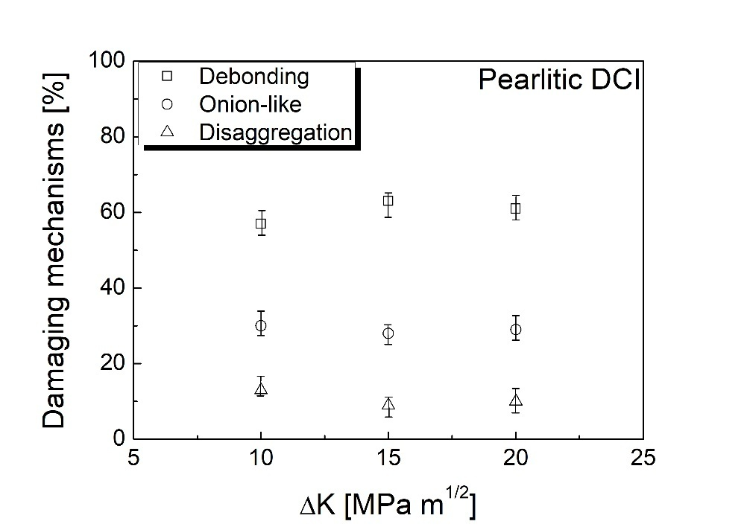
F. Iacoviello, V. Di Cocco
To be published
The number of graphite nodules on the fracture surface increases with the applied ΔK value.

Slide 25
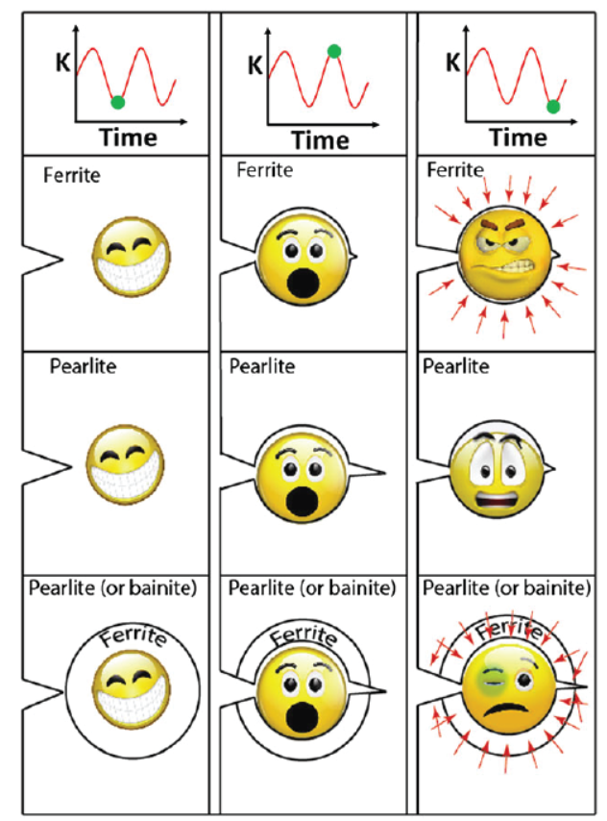
F. Iacoviello, V. Di Cocco, M. Cavallini
Fatigue crack propagation and overload damaging micromechanisms in a ferritic–pearlitic ductile cast iron
Fatigue Fract Engng Mater Struct, 39 (2016) 999–1011
The influence of graphite nodules presence and of phases distribution on crack closure:
- ferritic DCI: a ‘ductile debonding’ is observed; as a consequence, corresponding to lower K values, it is possible to propose the activation of a crack closure effect
induced by crack tip plasticity and enhanced by the nodules presence;
‐ pearlitic DCI: no ‘ductile debonding’ is observed; the graphite nodules contribution to the crack closure effect is lower if compared with the ferritic grade;
‐ ferritic–pearlitic DCI or ADI (with ferritic shell around the graphite nodules embedded in a bainitic matrix): as in ferritic DCI, graphite nodules act as crack closure effect raisers but a second peculiar crack closure effect based on the phases distribution and on the differences in the ferrite and pearlite (or bainite) mechanical behaviour implies lower crack growth rates especially corresponding to higher R and ΔK values

Slide 26
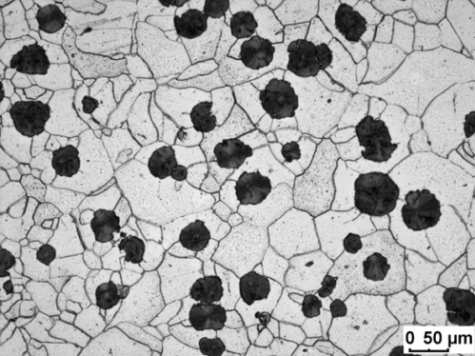
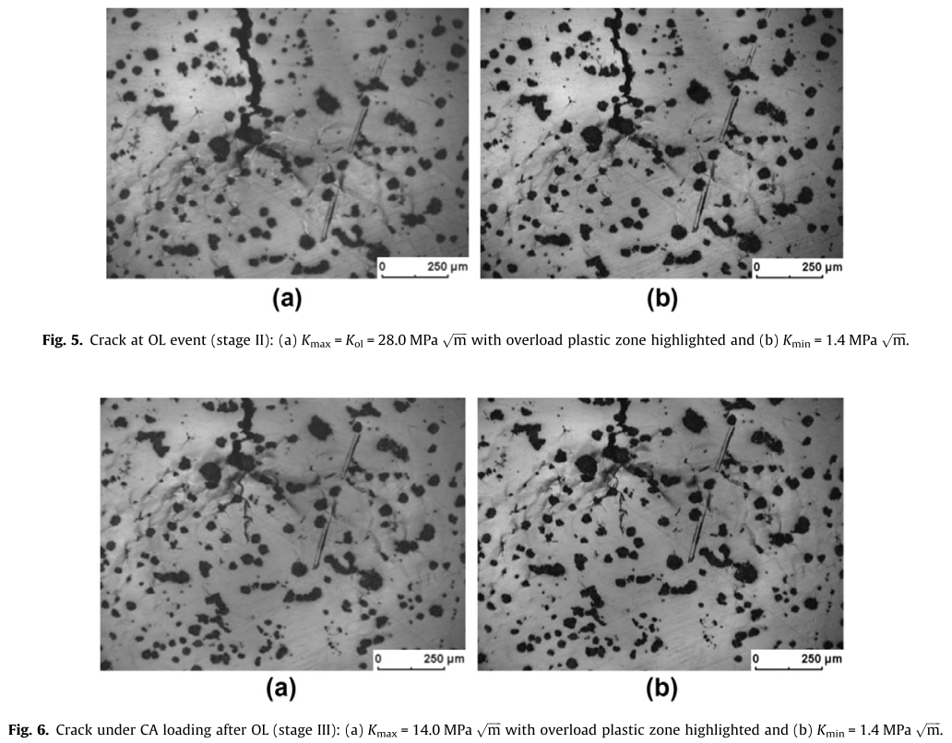
L. Zybell, H. Chaves, M. Kuna, T. Mottitschka, G. Pusch, H. Biermann
Optical in situ investigations of overload effects during fatigue crack growth in nodular cast iron
Engineering Fracture Mechanics 95 (2012) 45–56
A large crack growth acceleration when an overload is applied.
This acceleration is caused by limited ductile growth of two cracks towards the next particles by crack branching.

Slide 27
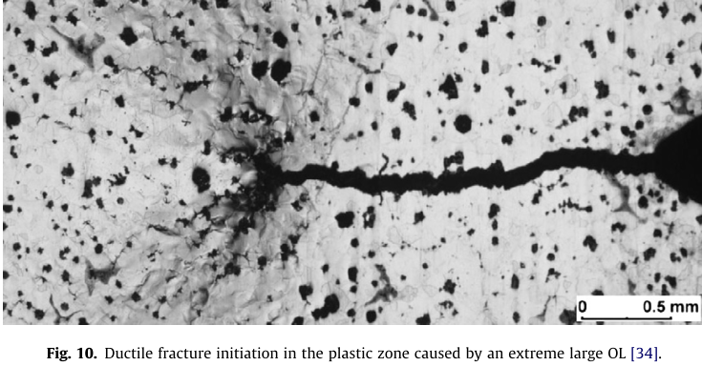
L. Zybell, H. Chaves, M. Kuna, T. Mottitschka, G. Pusch, H. Biermann
Optical in situ investigations of overload effects during fatigue crack growth in nodular cast iron
Engineering Fracture Mechanics 95 (2012) 45–56
The surfaces of the fatigue crack prior to the overload do not come in contact any more after the overload and so roughness induced crack closure is reduced to a minimum.

Slide 28
F. Iacoviello, V. Di Cocco
Influence of the graphite elements morphology on the fatigue crack propagation mechanisms in a ferritic ductile cast iron
Engineering Fracture Mechanics, 167 (2016) 248-258
Ferritic vs Ferritized DCIs

Slide 29
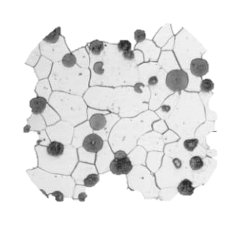
Finally … conclusions!!

Slide 30
Giornate CUIA
Bari, Italy, 11-12 October 2018
… thank you for your attention!!
Hoping you enjoyed
the presentation …

